Slide 1
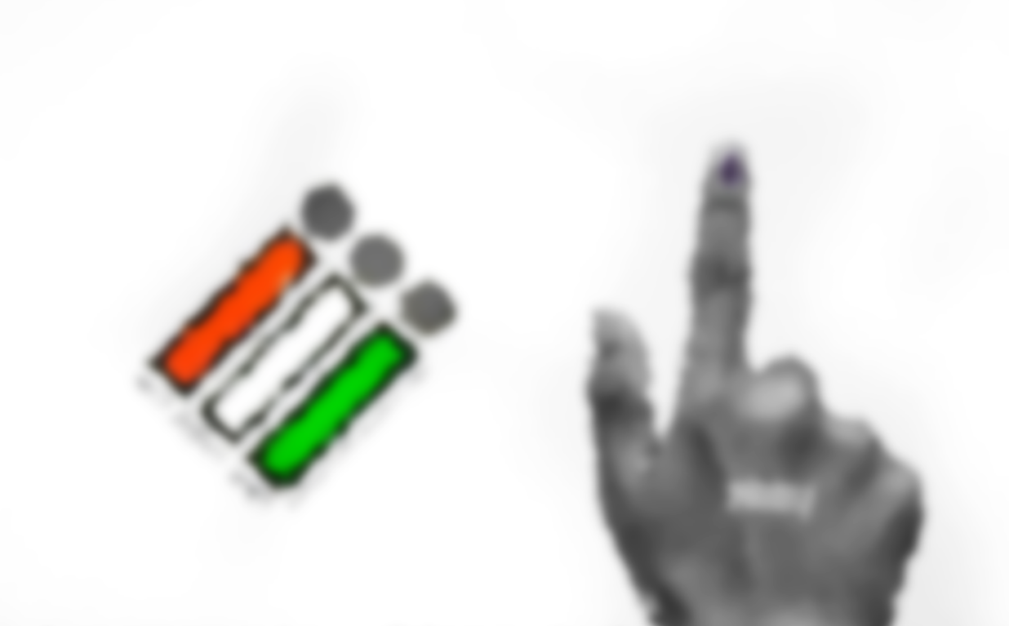
Election Analysis Project Documentation
Overview
The Election Analysis project focuses on visualizing the election data from India's 2014 and 2019 general elections. The project includes the creation of a dashboard that displays various analyses and visualizations of election results. The following documentation outlines the steps taken to complete this project.

Slide 2
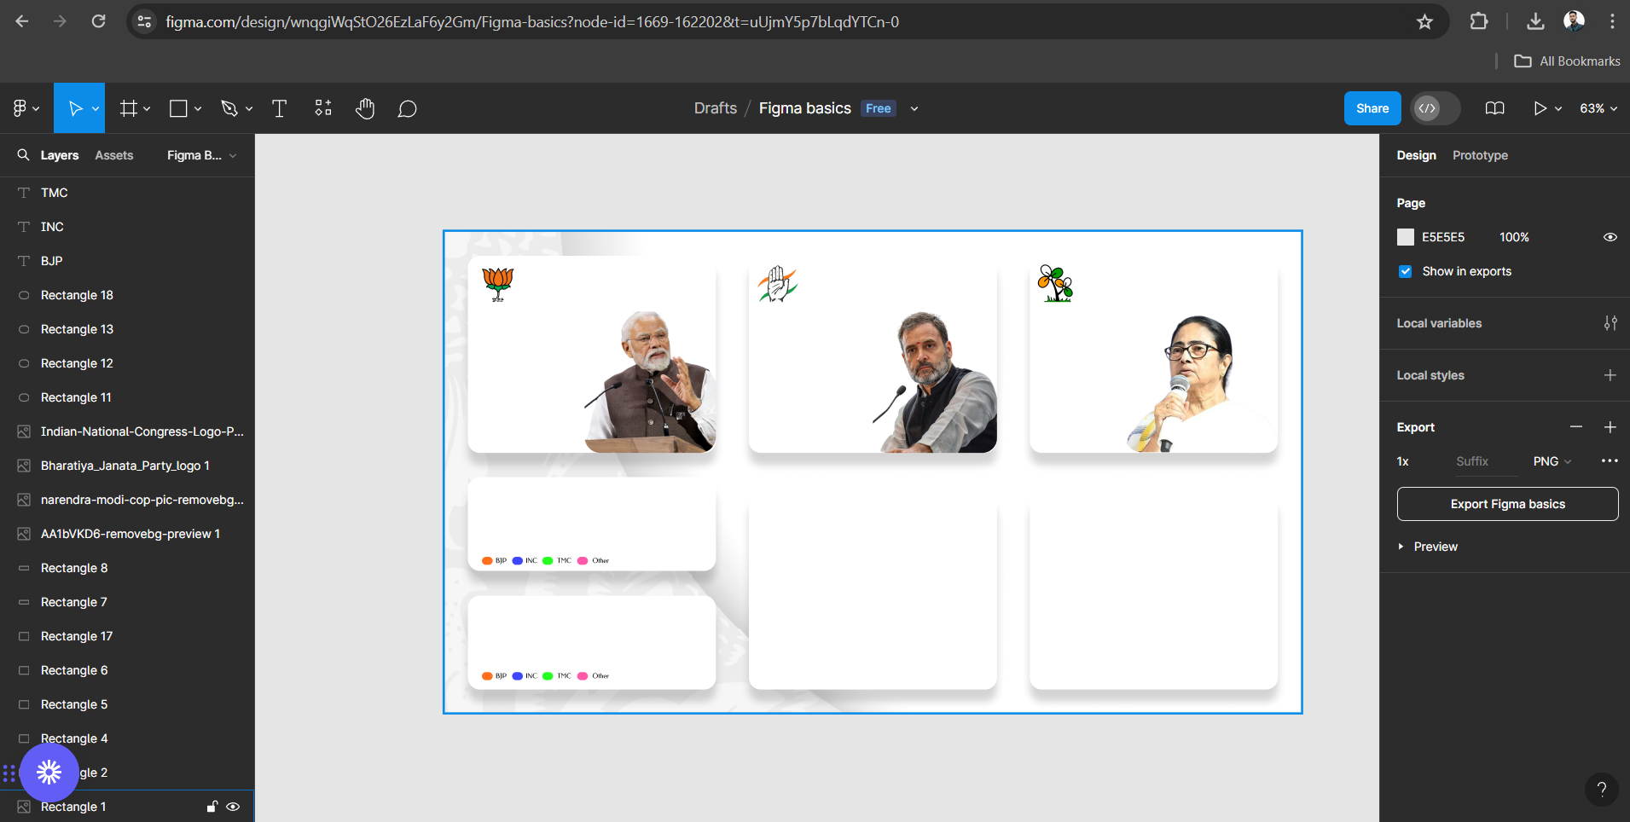
Project Steps
1. Designing the Dashboard
Tool Used: Figma
Action: Designed the entire layout and structure of the dashboard.
Purpose: To plan and organize the visual components and layout before implementation in Power BI.

Slide 3
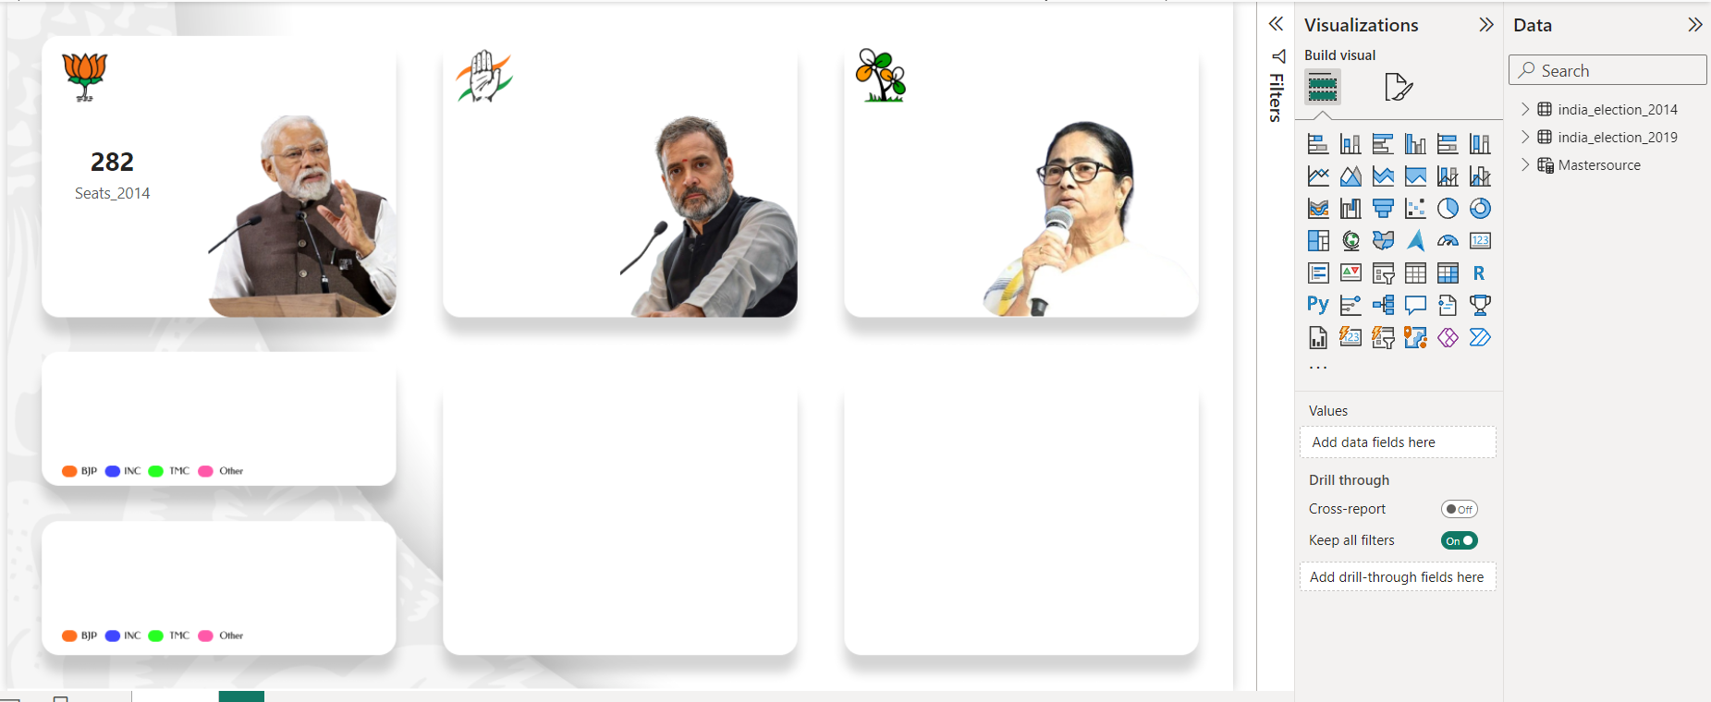
Project Steps
2. Implementing the Design in Power BI
Tool Used: Power BI
Action: Uploaded the design from Figma to Power BI.
Purpose: To begin the actual creation of the dashboard using the design as a blueprint.

Slide 4
Project Steps
3. Data Upload
Datasets Used : 2014 and 2019 Indian Election Data from Kaggle.
Action: Uploaded the datasets into Power BI.
Purpose: To have the necessary data for analysis and visualization.

Slide 5
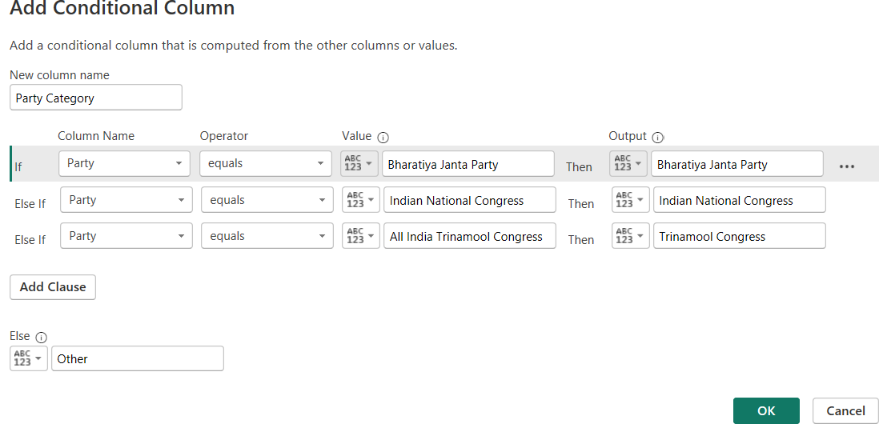
Project Steps
4. Data Preparation
Tools Used : Power Query.
Action: Added new columns using the Conditional Column method.
Details: Categorized data into four main parties: BJP, INC, TMC, and Others.
Purpose: To prepare the data for analysis by categorizing the parties for better insights.

Slide 6
Project Steps
5. Creating Measures
Tools Used : DAX (Data Analysis Expressions)
Measures Created
Total seats : Used `CALCULATE` function with `COUNT` function for 2014 and 2019 for parties BJP, INC, TMC, and Others.
Total Votes : Calculated the total votes for both years.
Purpose: To create key metrics for the analysis of election results.

Slide 7
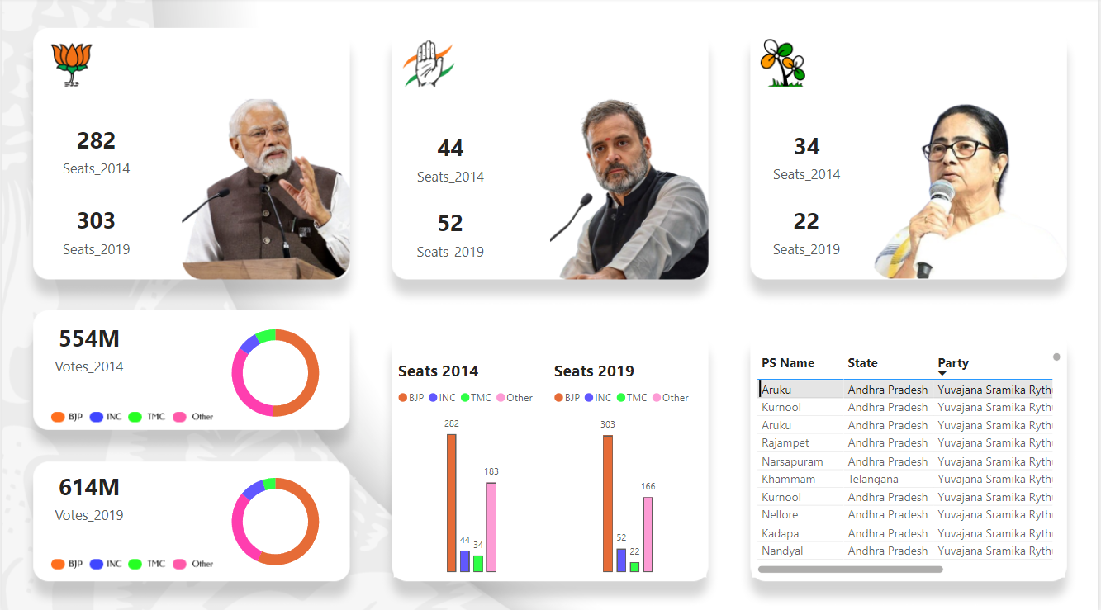
Project Steps
6. Visualization
Donut Charts:
Purpose: To visualize the distribution of votes among the parties.
Column Charts:
Purpose: To display the visual count of votes for the respective parties.

Slide 8
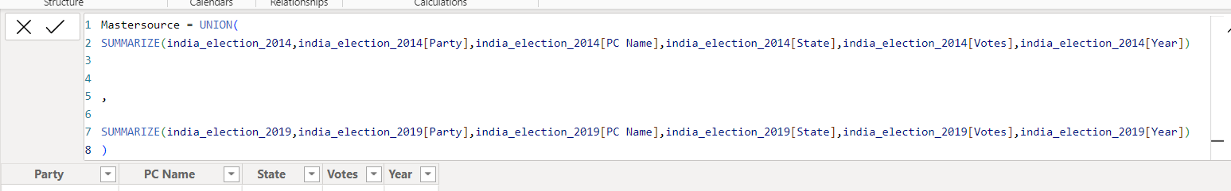
Project Steps
7. Creating a Master Table
Tool Used: DAX
Function Used: `UNION` and `SUMMARIZE`
Action: Created a new table named `Mastersource`.
Details: Combined data to view PS Name, Party, Votes, and Year in a single table from the existing tables.
Purpose: To consolidate key information into a single table for better reporting.

Slide 9
Final Output
Dashboard
Components
KPIs showing total seats, total votes occupied by the parties
Donut charts showing vote distribution.
Column charts showing vote counts.
Master table with PS Name, Party, Votes, and Year.

Slide 10
Conclusion
This project showcases the election analysis of India's 2014 and 2019 general elections through a well-structured dashboard. The steps involved from designing in Figma, uploading datasets, data preparation, creating measures, visualizations, and consolidating data into a master table, ensure comprehensive and insightful analysis.

